Slide 1
Employability is not
A job
The result of good grades
Definable at the individual level
Something that arrives magically at graduation
A destination (it’s a journey)
Solved by WIL
The responsibility of one stakeholder
Something created in the final year of studies
Any different to what all academics want to see in good students

Slide 2
Employability is the means to create and sustain meaningful life and work for the benefit of oneself and others
It is the purpose of education and requires the contribution of all stakeholders

Slide 3
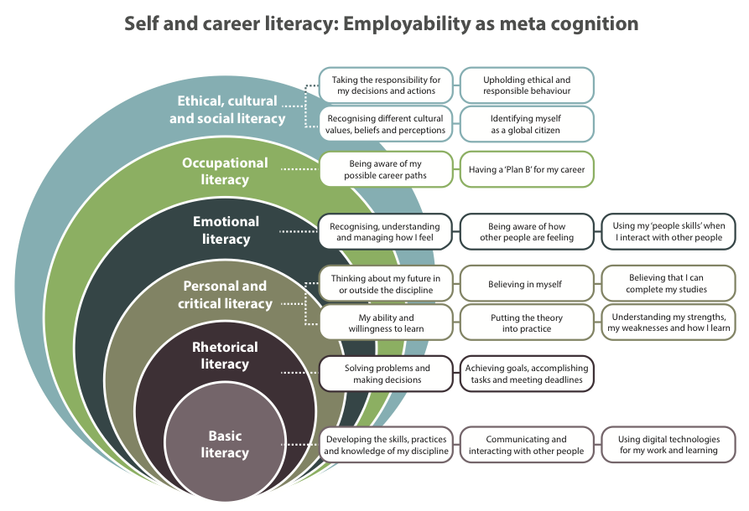
Literacies for life

Slide 4
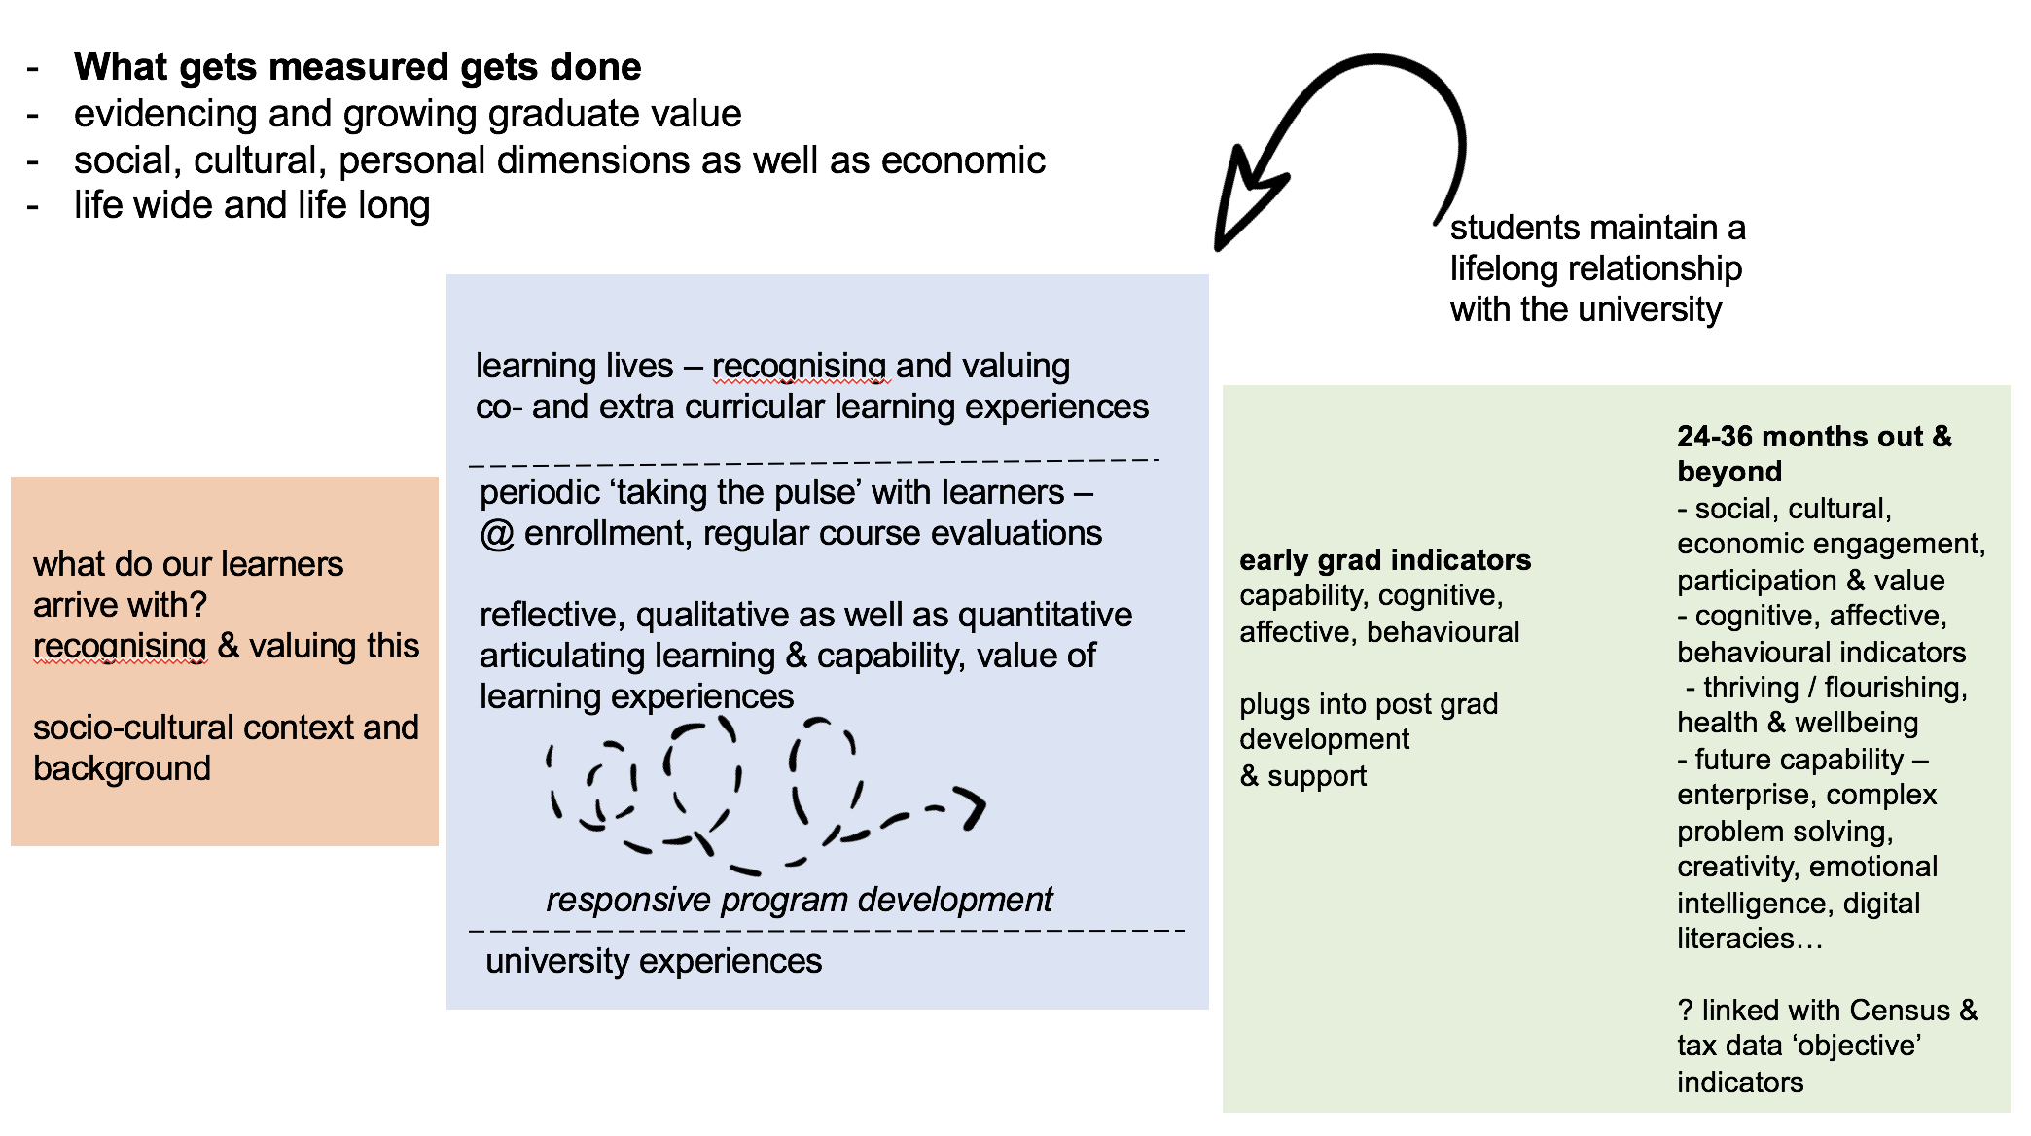

Slide 5
How?
Evaluation process: current approaches to graduate outcome measurement – GOS
identify strengths and gaps
Development of sector level outcomes - standards for graduate capability
University level strategies, integration into programs

Slide 6
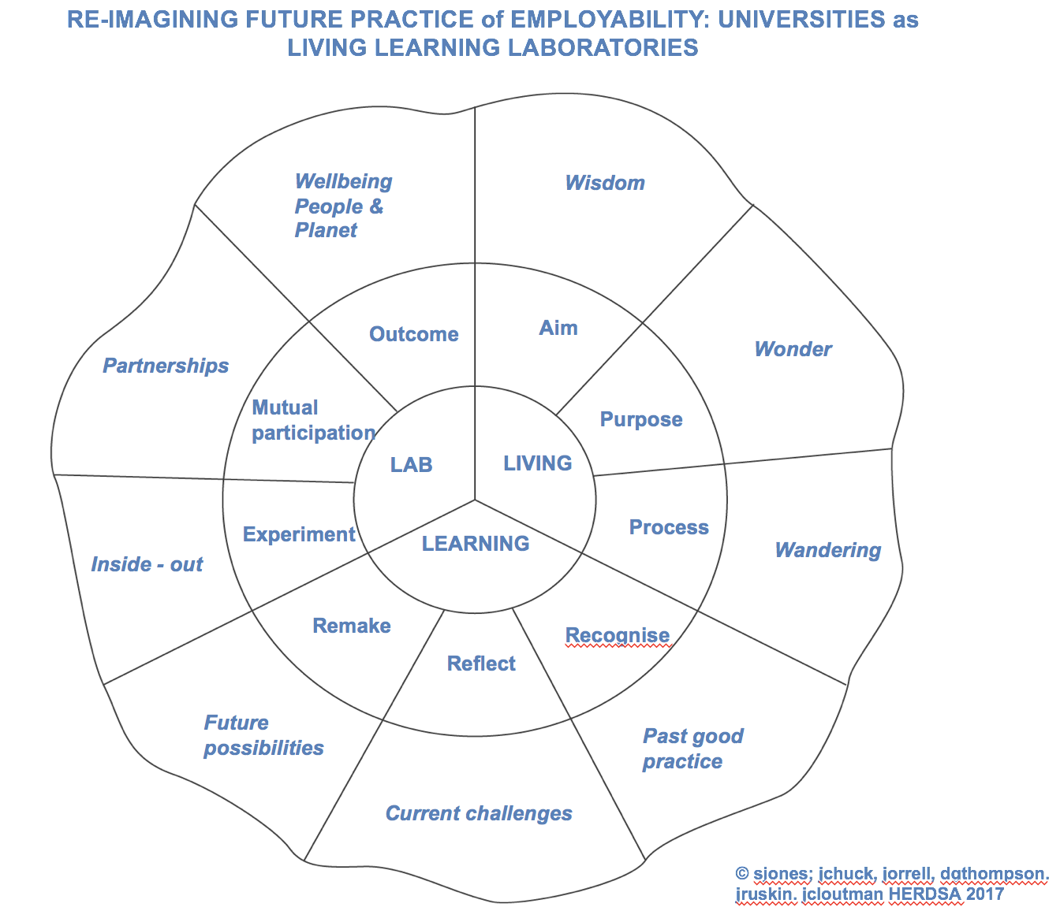

Slide 7
www.developingemployability.edu.au

Slide 8
Dimensions of Good Practice in Employability Education
 | Collaborative | Coherent | Integrated | Contextualised | Explicit
Policy
Governance
Curricula
Practice/Delivery
Enablers
Leadership
Resourcing
Rewards and recognition
Expertise

Slide 9
